Slide 1
Functions

Slide 2
Definition of Functions
Given any sets X, Y, a function f from (or “mapping”) X to Y (f:X→Y) is an assignment of exactly one element f(x)∈Y
to each element x∈X.
For every x∈X there is unique y∈Y.

Slide 3
Function - Mapping, map operation transformation
f:X→Y, <x,y> ∈ f , x –argument, y-image of x under f
Y = f(x) value of function at x

Slide 4
Graphical Representations
Functions can be represented graphically in several ways:
f
X
Y
•
•
f
•
•
•
•
•
y
x
y
•
•
•
•
x
X
Y
Graph
Plot
Like Venn diagrams

Slide 5
Definition of Functions (cont’d)
Formally: given f:A→B
“x is a function” :≡ (¬∃x,y: x=y ∧ f(x) ≠ f(y)) or
“x is a function” :≡ (∀ x,y: ¬(x=y) ∨ ¬(f(x) ≠ f(y))) or
“x is a function” :≡ (∀ x,y: ¬(x=y) ∨ (f(x) = f(y))) or
“x is a function” :≡ (∀ x,y: (x=y) → (f(x) = f(y))) or
“x is a function” :≡ (∀ x,y: (f(x) ≠ f(y)) → (x ≠ y))

Slide 6
Some Function Terminology
If f:X→Y, and f(x)=y (where a∈X & b∈Y), then:
  X is the domain of f. Df = X
  Y is the codomain of f. Rf = Y
  y is the image of x under f.
  x is a pre-image of y under f.
    In general, y may have more than one pre-image.
  The range R⊆Y of f is {y | ∃x f(x)=y }.

Slide 7
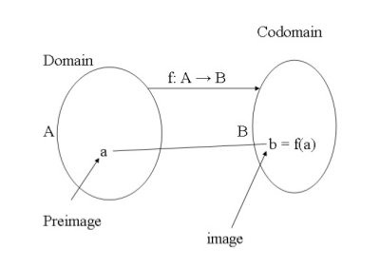

Slide 8
Range vs. Codomain - Example
Suppose that: “f is a function mapping students in this class to the set of grades {A,B,C,D,E}.”
At this point, you know f’s codomain is: __________, and its range is ________.
Suppose the grades turn out all As and Bs.
Then the range of f is _________, but its codomain is __________________.
{A,B,C,D,E}
unknown!
{A,B}
still {A,B,C,D,E}!

Slide 9
Function Addition/Multiplication
We can add and multiply functions
f,g:R→R:
  (f + g):R→R, where (f + g)(x) = f(x) + g(x)
  (f × g):R→R, where (f × g)(x) = f(x) × g(x)

Slide 10
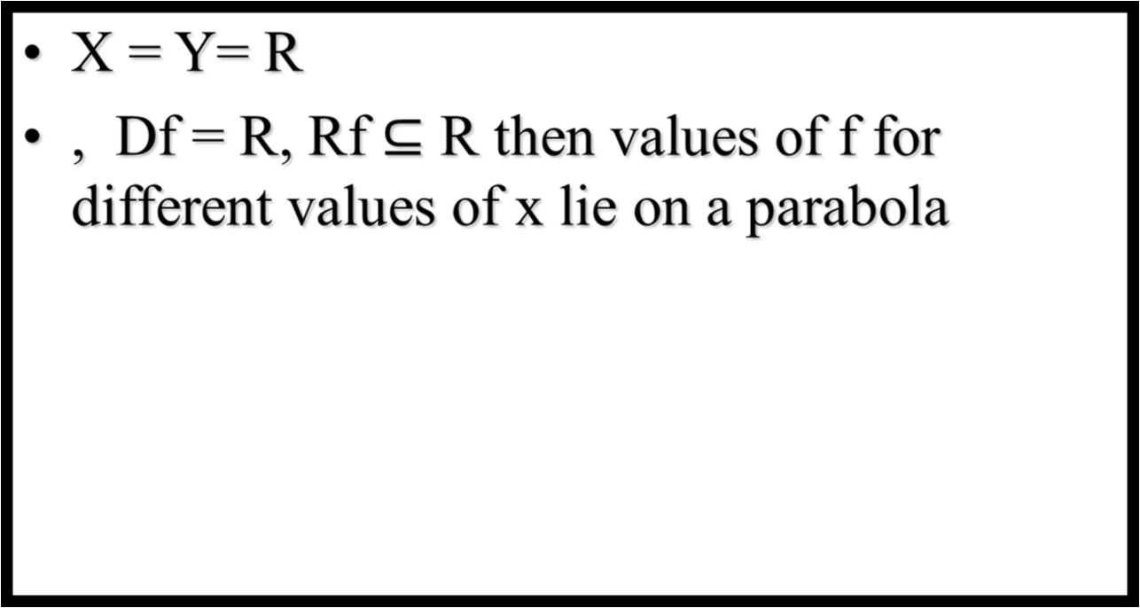
f(x)
f(x) = x² +2
x
0

Slide 11
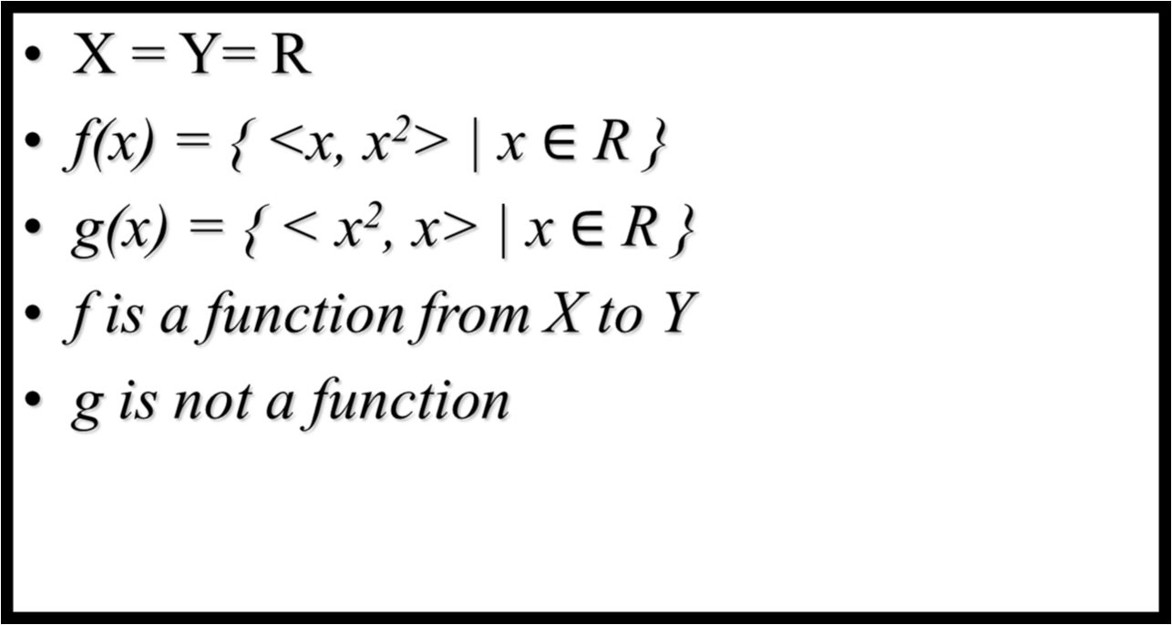

Slide 12
A Couple of Key Functions
In discrete math, we frequently use the following functions over real numbers:
  ⎣x⎦ (“floor of x”) is the largest integer ≤ x.
  ⎡x⎤ (“ceiling of x”) is the smallest integer ≥ x.
  The floor function assigns to the real number x the largest integer that is less than or equal to x. The value of the floor function at x is denoted by └^{x}┘

Slide 13
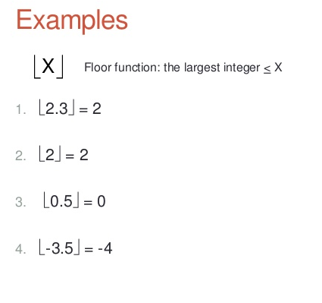

Slide 14
The ceiling function assigns to the real number x the smallest integer that is greater than or equal to x.
The value of the ceiling function at x is denoted by ┌_{x}┐

Slide 15
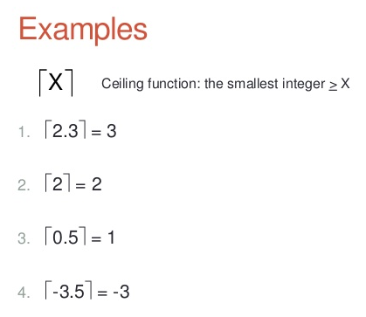

Slide 16
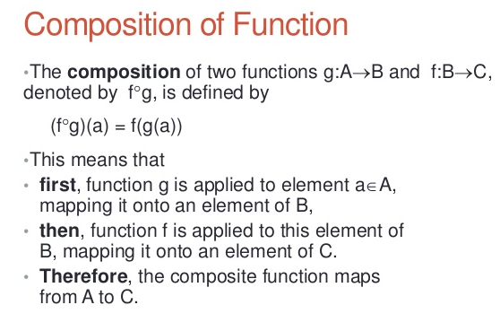
Function Composition

Slide 17
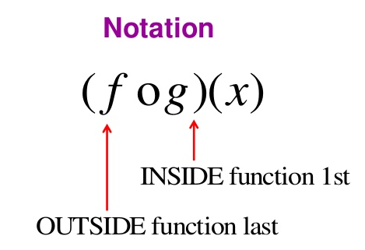

Slide 18
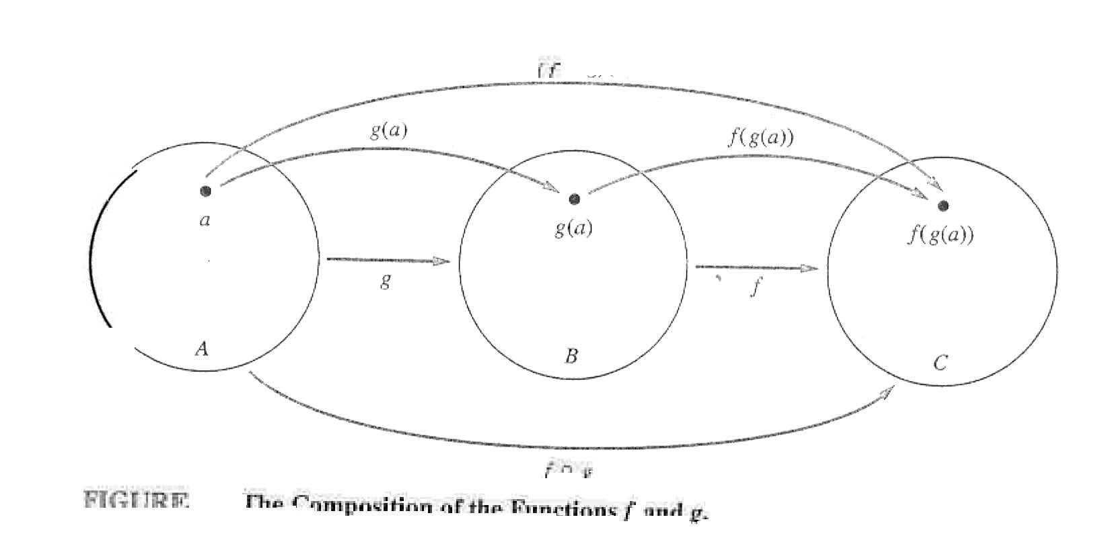
Function Composition

Slide 19
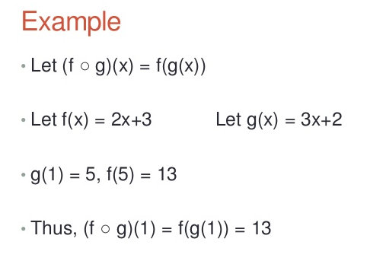

Slide 20
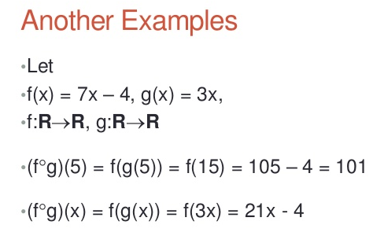

Slide 21
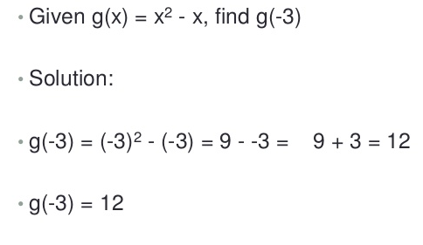

Slide 22
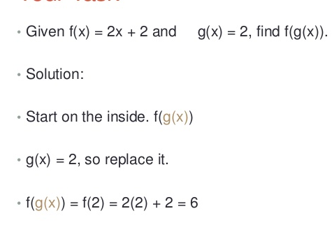

Slide 23
One-to-One Functions
A function is one-to-one (1-1), or injective, or an injection, iff every element of its range has only one pre-image.
Only one element of the domain is mapped to any given one element of the range.
  Domain & range have same cardinality. What about codomain?
May Be
Larger

Slide 24
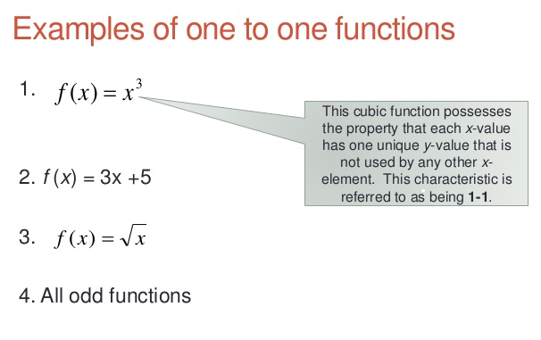

Slide 25
One-to-One Functions (cont’d)
Formally: given f:A→B
“x is injective” :≡ (¬∃x,y: x≠y ∧ f(x)=f(y)) or
“x is injective” :≡ (∀ x,y: ¬(x≠y) ∨ ¬(f(x)=f(y))) or
“x is injective” :≡ (∀ x,y: ¬(x≠y) ∨ (f(x) ≠ f(y))) or
“x is injective” :≡ (∀ x,y: (x≠y) → (f(x) ≠ f(y))) or
“x is injective” :≡ (∀ x,y: (f(x)=f(y)) → (x =y))

Slide 26
One-to-One Illustration
Graph representations of functions that are (or not) one-to-one:
•
•
•
•
•
•
•
•
•
•
•
•
•
•
•
•
•
•
•
•
•
•
•
•
•
•
•
Not one-to-one
Not even a
function!
One-to-one

Slide 27
Onto (Surjective) Functions
A function f:A→B is onto or surjective or a surjection iff its range is equal to its codomain (∀b∈B, ∃a∈A: f(a)=b).
An onto function maps the set A onto (over, covering) the entirety of the set B, not just over a piece of it.
  e.g., for domain & codomain R, x³ is onto, whereas x² isn’t. (Why not?)

Slide 28
Illustration of Onto
Some functions that are or are not onto their codomains:
•
•
•
•
•
•
•
•
•
•
•
•
•
•
•
•
•
•
•
•
•
•
•
•
•
•
•
•
•
•
•
•
•
•
•
Onto
(but not 1-1)
Not Onto
(or 1-1)
Both 1-1
and onto
1-1 but
not onto

Slide 29
Bijections
A function f is a one-to-one correspondence, or a bijection, or reversible, or invertible, iff it is both one-to-one and onto.

Slide 30
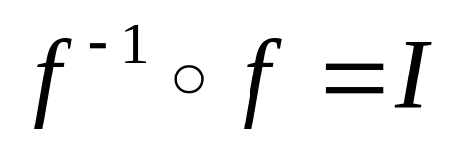
Inverse of a Function
For bijections f:A→B, there exists an inverse of f, written f ⁻¹:B→A, which is the unique function such that:

Slide 31
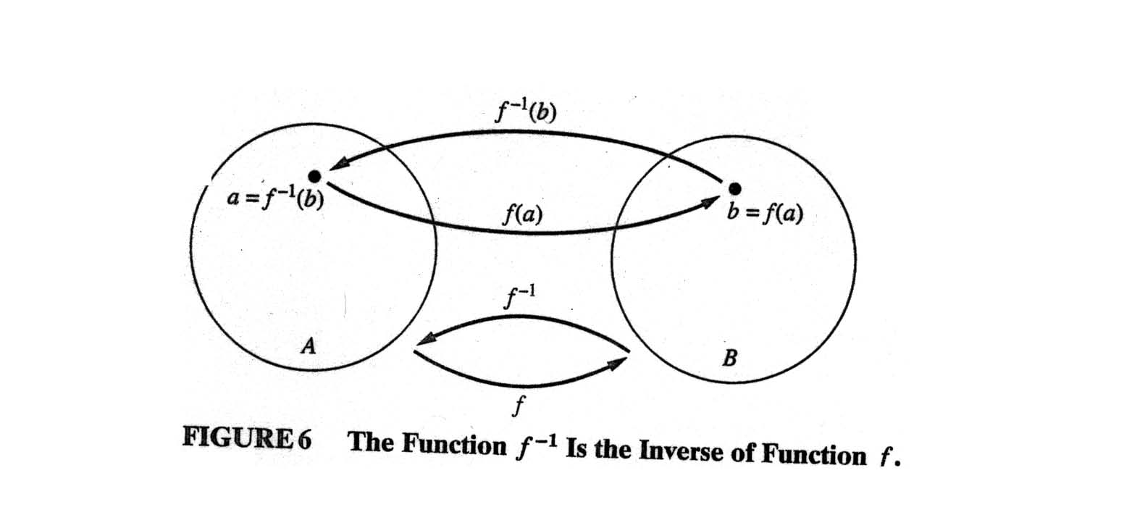
Inverse of a function (cont’d)

Slide 32
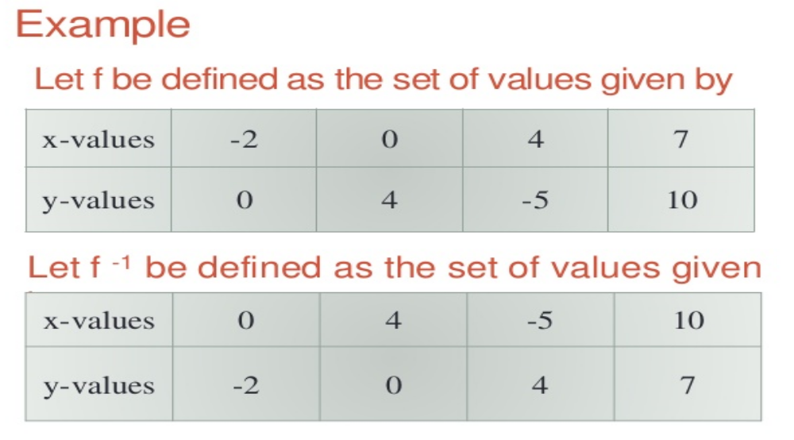

Slide 33
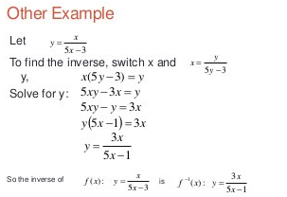

Slide 34
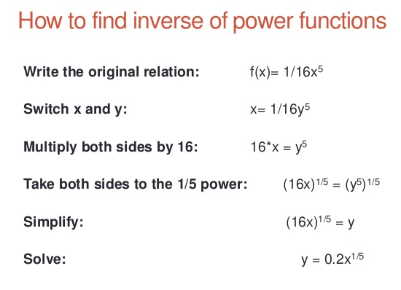

Slide 35
The Identity Function
For any domain A, the identity function I:A→A (variously written, I_{A}, 1, 1_{A}) is the unique function such that ∀a∈A: I(a)=a.
Some identity functions you’ve seen:
  ∧ing with T, ∨ing with F, ∪ing with ∅, ∩ing with U.
Note that the identity function is both one-to-one and onto (bijective).

Slide 36
Identity Function Illustrations
The identity function:
•
•
•
y
•
•
•
•
•
•
Domain and range
x

Slide 37
